Slide 1
Mixed Reality
Mohr et al., “Mixed Reality Light Fields for Interactive Remote Assistance”. In Proceedings of the 2020 CHI Conference on Human Factors in Computing Systems (CHI '20)
Zhou et al., “Gripmarks: Using Hand Grips to Transform In-Hand Objects into Mixed Reality Input”. In Proceedings of the 2020 CHI Conference on Human Factors in Computing Systems (CHI '20)
Mixed reality includes augmented reality, virtual reality, and other mixed configurations

Slide 2
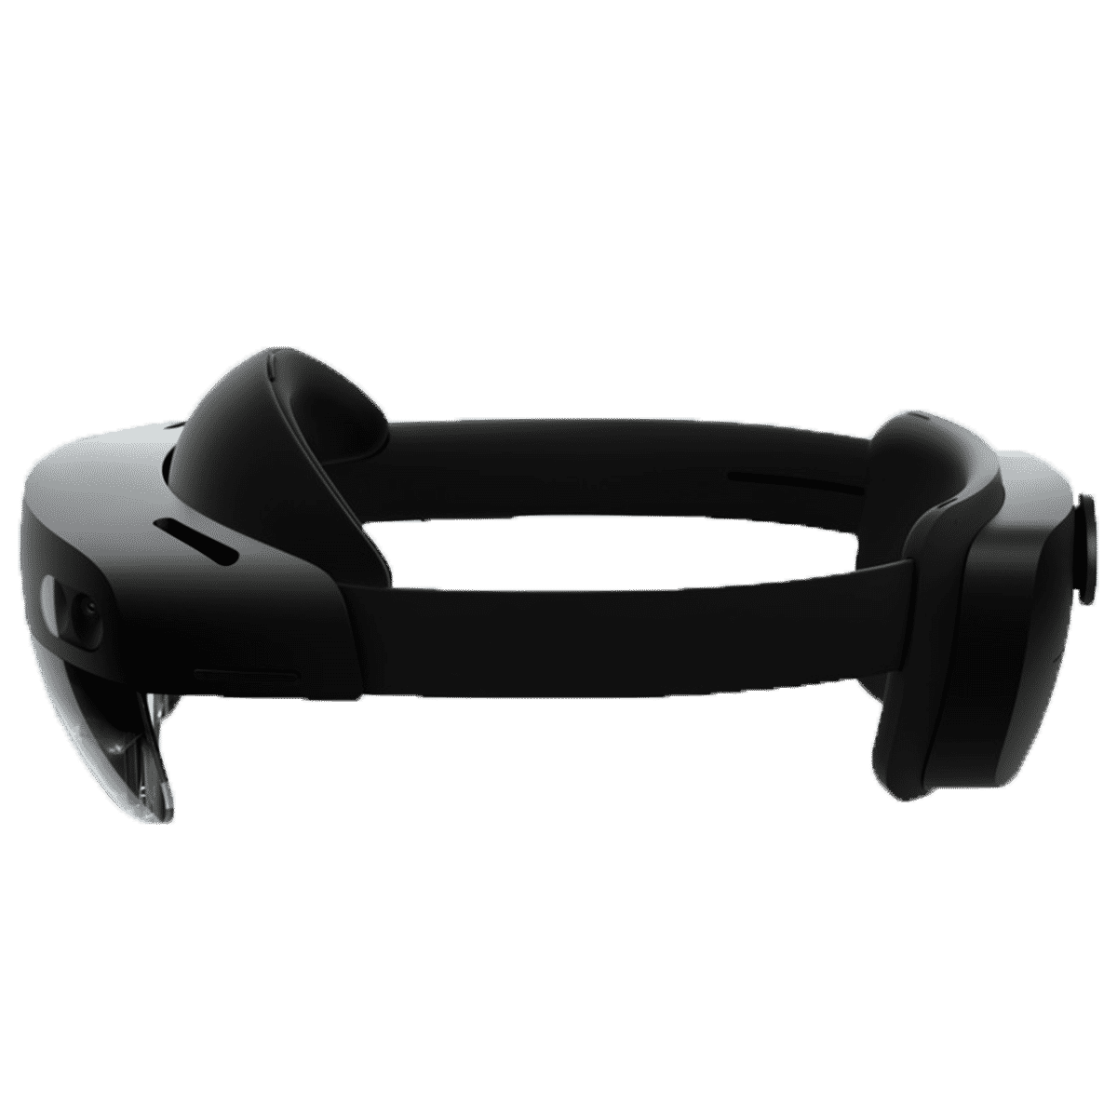
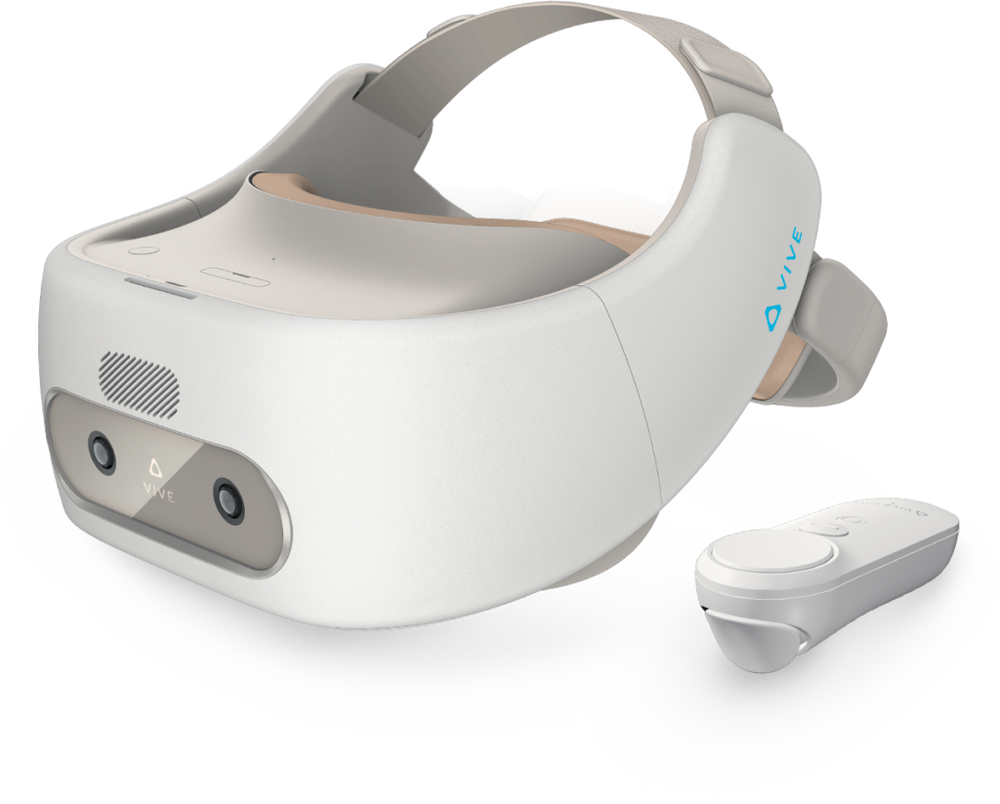
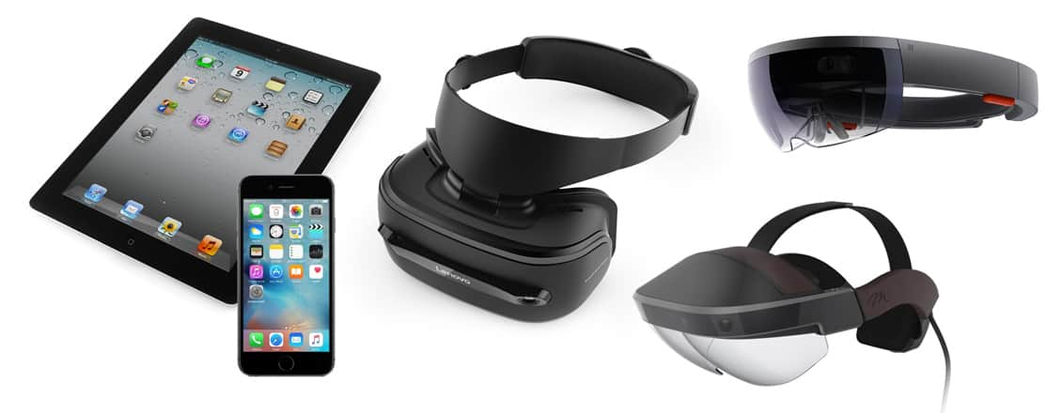
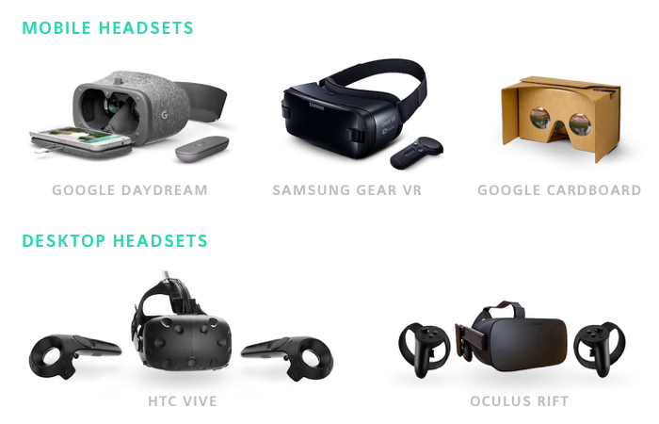
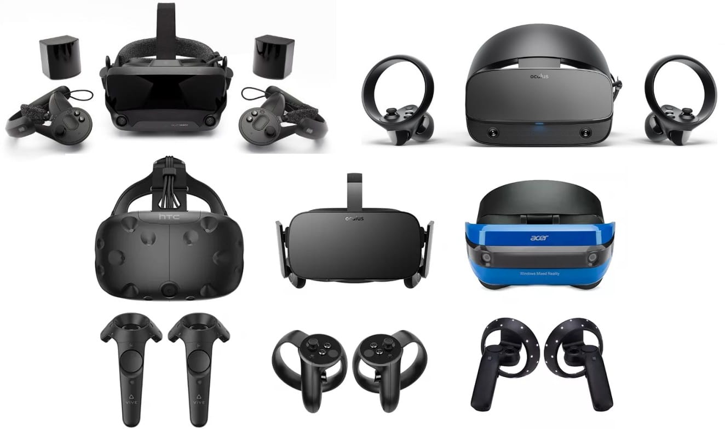
VR, AR, and MR Technologies
Mixed Reality (MR)
Augmented Reality (AR)
Virtual Reality
Notes:
Mixed reality includes augmented reality, virtual reality, and other mixed configurations

Slide 3
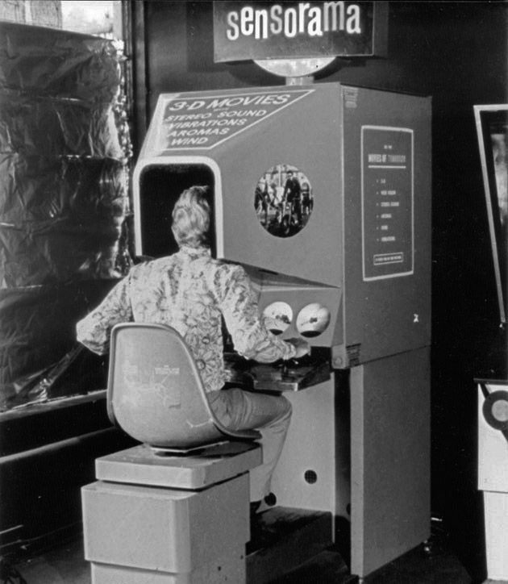
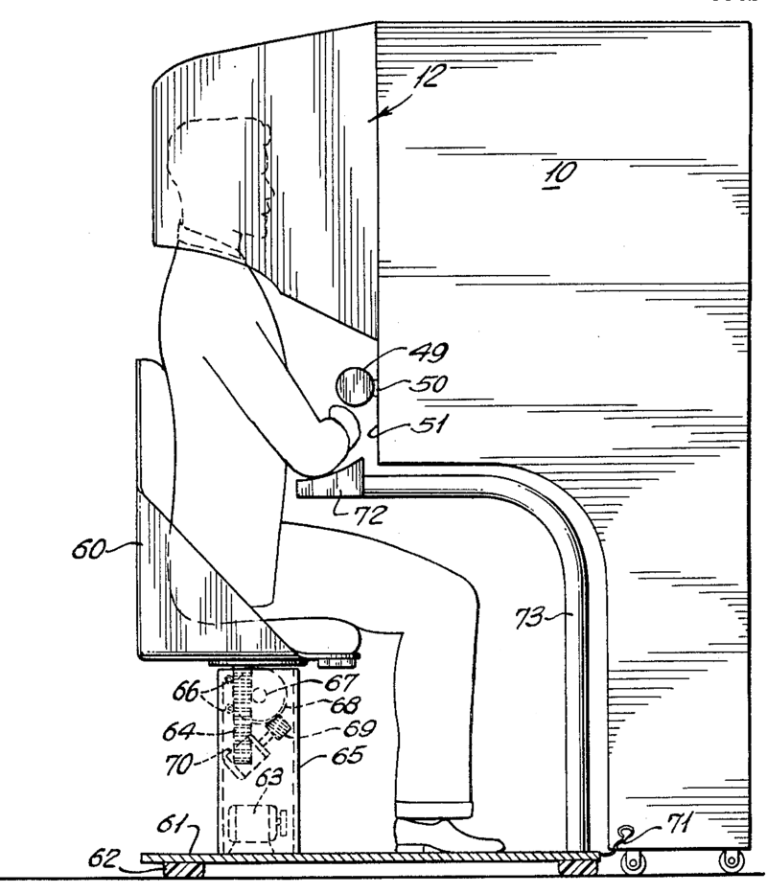
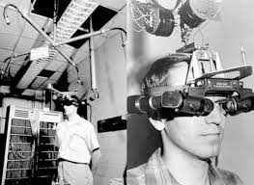
Early History
SENSORAMA: built in 1962 by Morton Heilig and was aimed at 4 senses
THE ULTIMATE DISPLAY: built in 1965 by Ivan Sutherland: A big breakthrough
Notes:
Mixed reality includes augmented reality, virtual reality, and other mixed configurations

Slide 4
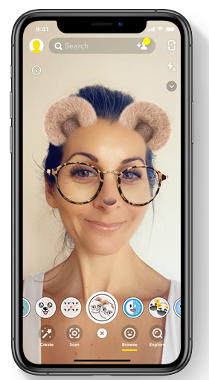
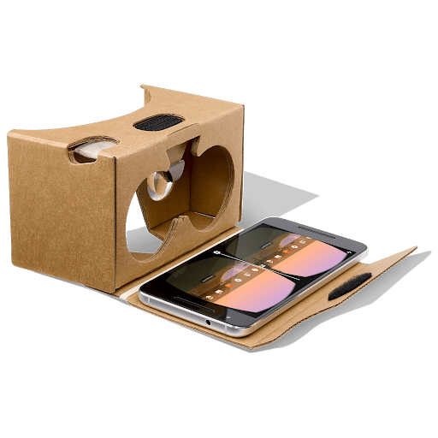
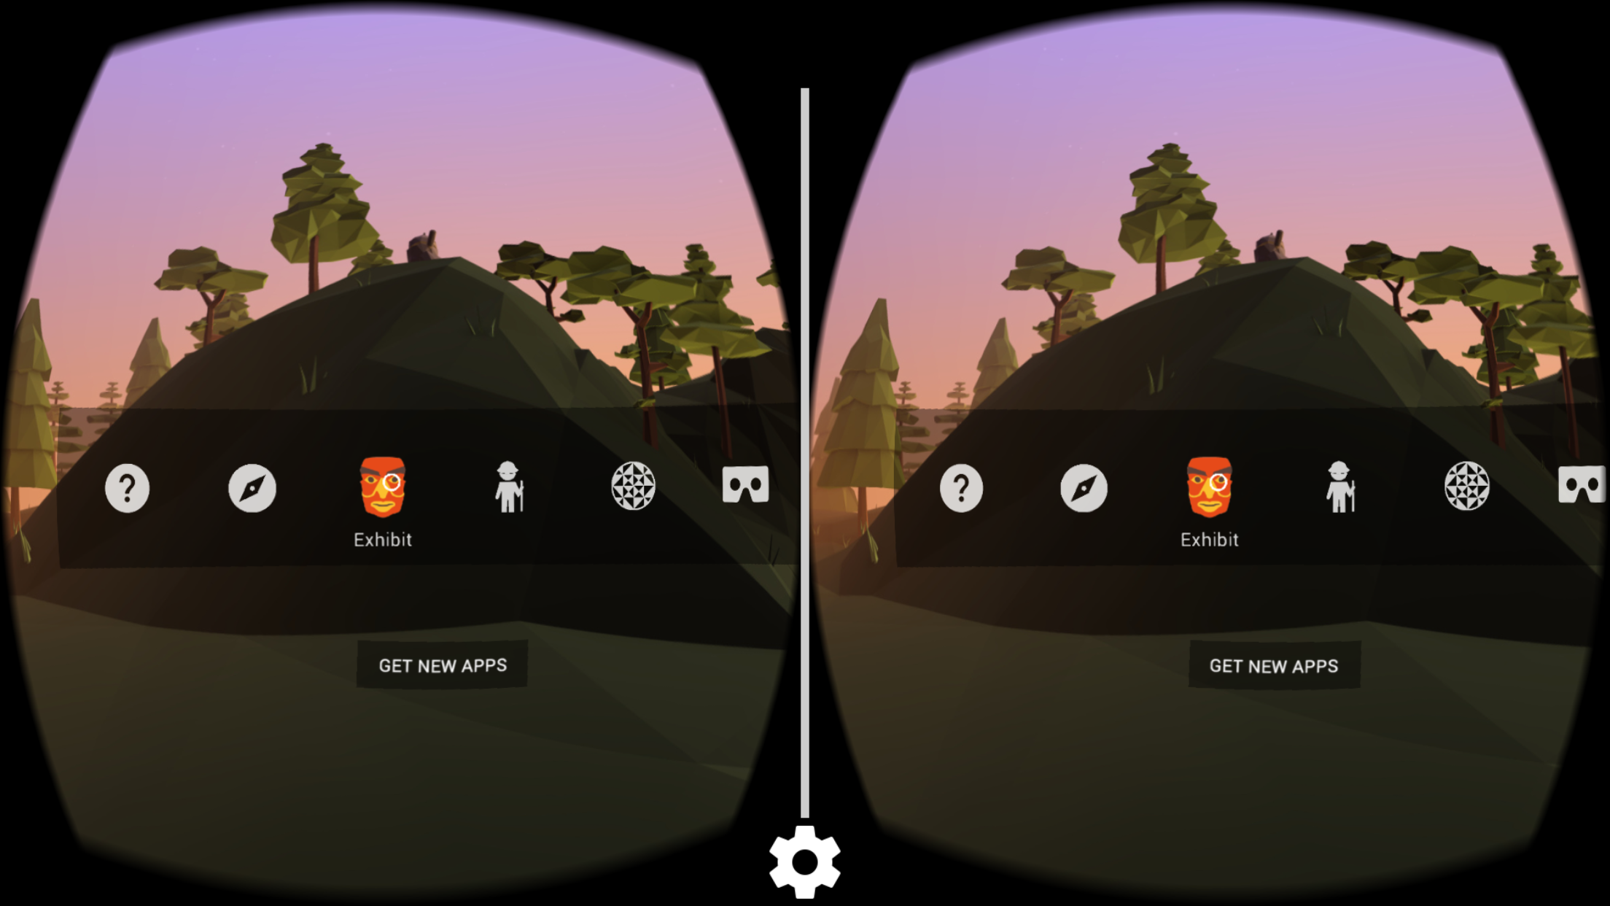
Hand-Held Displays (HHDs)
Snapchat for mobile phone
JigSpace for iPad
Google Cardboard app for mobile phone
Notes:
Mixed reality includes augmented reality, virtual reality, and other mixed configurations

Slide 5
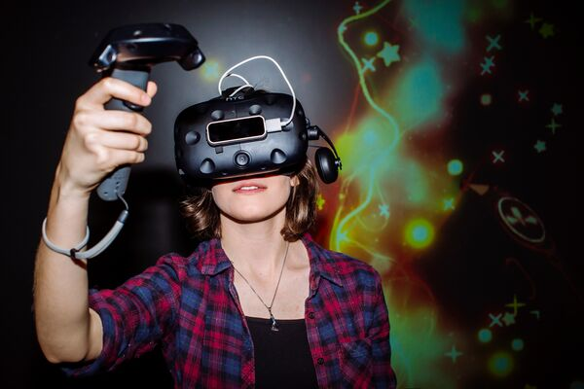
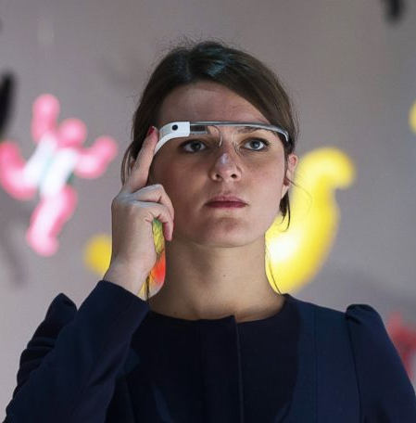
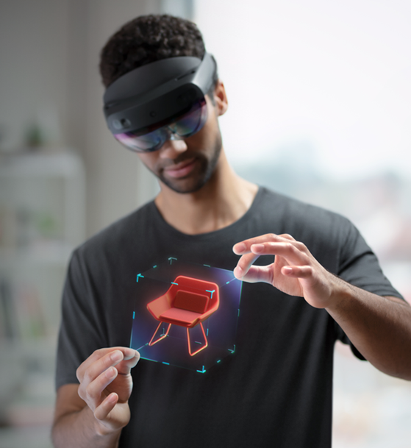
Head-Mounted Displays (HMDs)
HTC VIVE
Google Glass
Microsoft HoloLens 2
Notes:
Mixed reality includes augmented reality, virtual reality, and other mixed configurations

Slide 6
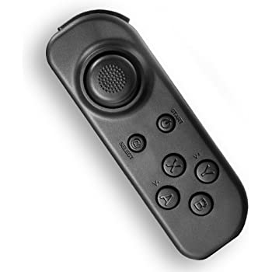
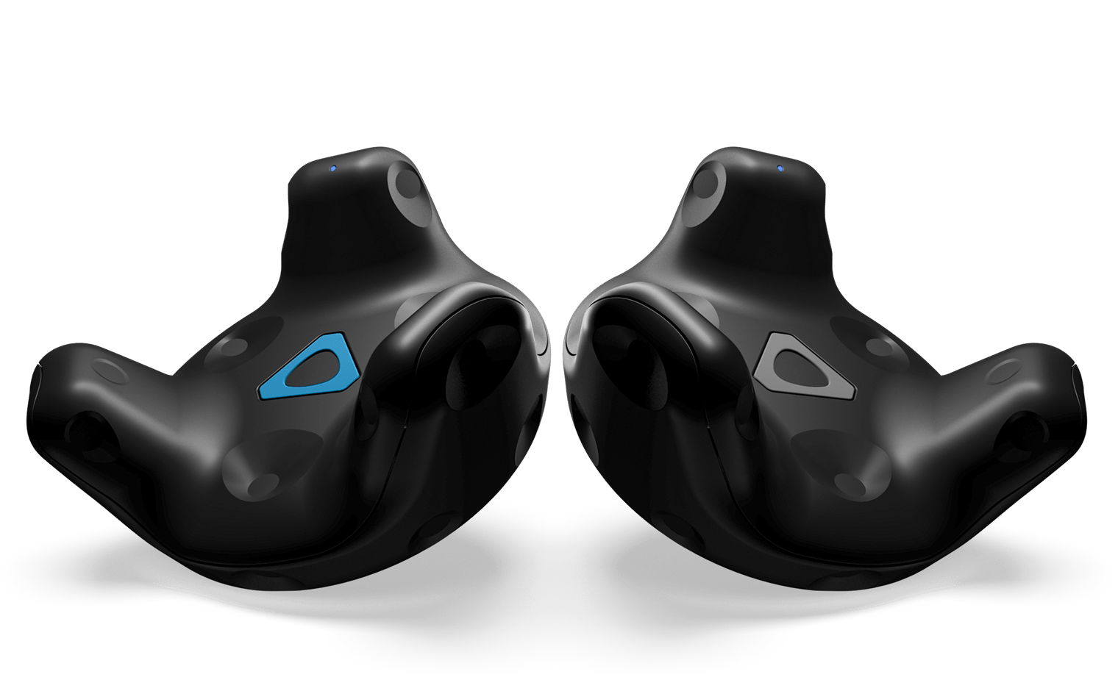
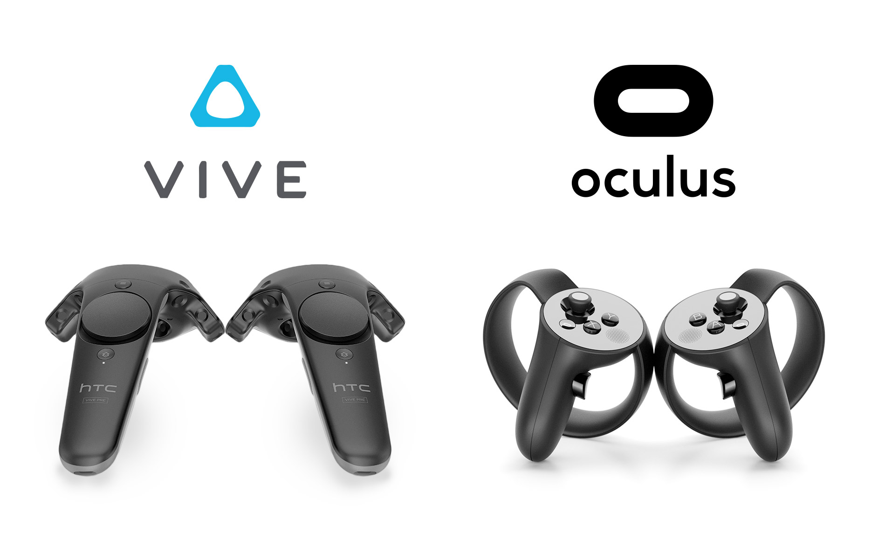
Control Devices
ESTEK VR Controller
VIVE Tracker
HTC VIVE
Oculus Touch
Notes:
Control virtual objects in 3 dimensions.

